Slide 1

Lecture 6 - Operations
Gilbert.Lau@DataStax.com
Partner Architect
+1 408 357 4528
@glau_sf

Slide 2
Getting Started: Pro-Tips
Use appropriate infrastructure
Get your data model right
Know the DataStax driver
Code good query patterns
Size your cluster correctly

Slide 3
Getting Started: Pro-Tips
Use appropriate infrastructure
Get your data model right
Know the DataStax driver
Code good query patterns
Size your cluster correctly
Nodes not too big
Nodes not too small
^ See docs
Avoid shared storage
Physical or virtual are OK

Slide 4
Getting Started: Pro-Tips
Use appropriate infrastructure
Get your data model right
Know the DataStax driver
Code good query patterns
Size your cluster correctly
Denormalize
No RDBMS models
No secondary indexes
Get help if you’re stuck!
Great online resources

Slide 5
Getting Started: Pro-Tips
Use appropriate infrastructure
Get your data model right
Know the DataStax driver
Code good query patterns
Size your cluster correctly
Load balancing/routing
Retry and auto-failover
Session management
Language features

Slide 6
Getting Started: Pro-Tips
Use appropriate infrastructure
Get your data model right
Know the DataStax driver
Code good query patterns
Size your cluster correctly
Asynchronous queries
Prepared statements
Use batches correctly

Slide 7
Getting Started: Pro-Tips
Use appropriate infrastructure
Get your data model right
Know the DataStax driver
Code good query patterns
Size your cluster correctly
Correct number of nodes
Use default heap settings
Always load test

Slide 8
DSE Performance Basics
Can DSE be both bigger and faster? Yes it can.
More Throughput? More Data?
Use more nodes (scale out)
Do not use too big nodes (scale up)
Know Cassandra ops best practices Use OpsCenter to monitor, alert, repair
Faster Operations? Predictable Latency?
Check your data model and queries
Use asynchronous queries
Use prepared statements
Compaction tuning or maybe strategy

Slide 9
Take DataStax Ops Training. It’s Free.
Deploy your cluster correctly
Monitor and alert the right metrics
Use repair correctly
Scale out

Slide 10
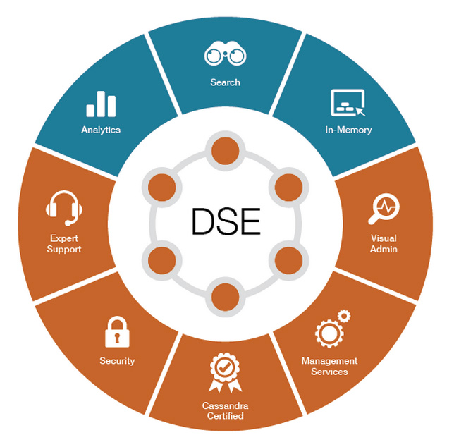
Why DSE Instead of Open Source?
Time to Market
We built the
integrations for you.
Lower TCO
It’s easy to operate.
Open source code
can be painful.

Slide 11
Lab 8 – Operations
https://github.com/DSPN/DataStaxDay

